Slide 1
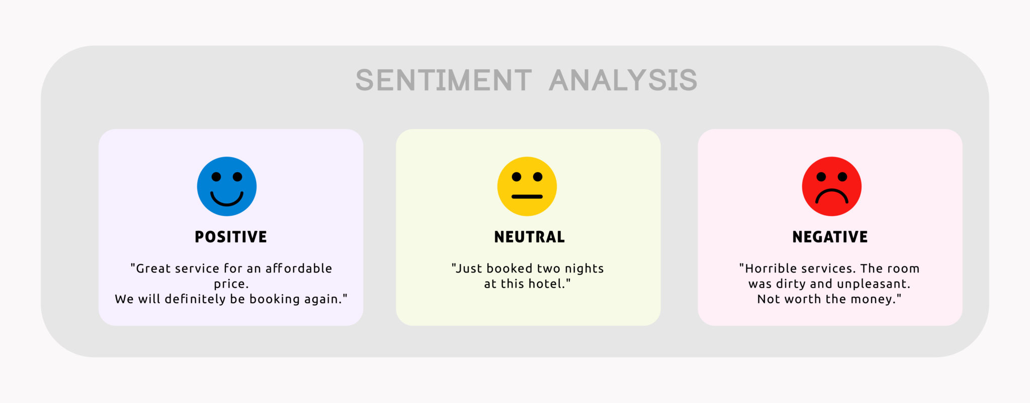
Sentiment Analysis
Team-8

Slide 2
Objective
The primary goal of sentiment analysis project is to demonstrate the applicaton of machine learning and NLTK in sentiment analysis.
Steps Includes:
Collect and preprocess relevant text data.
Build and train a sentiment analysis model using machine learning algorithms.
Evaluate the model's performance and analyze the insights gained from sentiment analysis.

Slide 3
Introduction
Sentiment analysis, also known as opinion mining, is the process of extracting subjective information from text data to determine the sentiment or emotional tone expressed.
It involves analyzing text to classify it as positive, negative, or neutral, providing valuable insights into public opinion, customer feedback, and social trends.

Slide 4

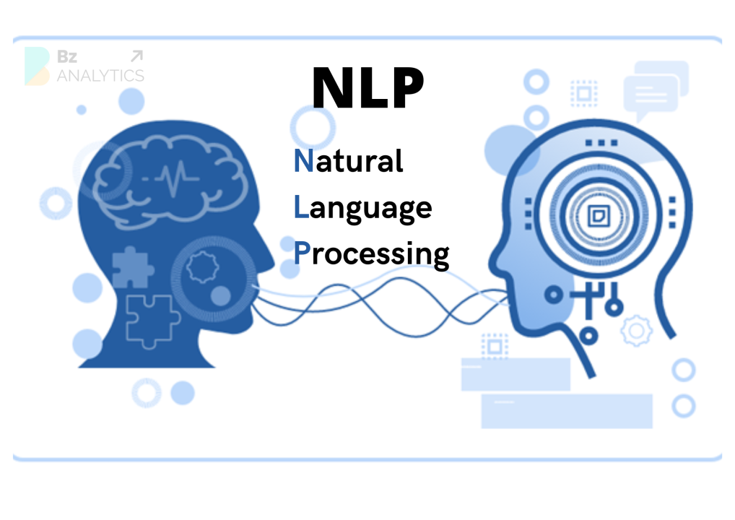
Technologies Used
Machine Learning
NLP
PYTHON

Slide 5
Working Steps
Data Collection
Data Preprocessing
Exploratory Data Analysis (EDA)
Sentiment Analysis
Customer Segmentation
Predictions

Slide 6
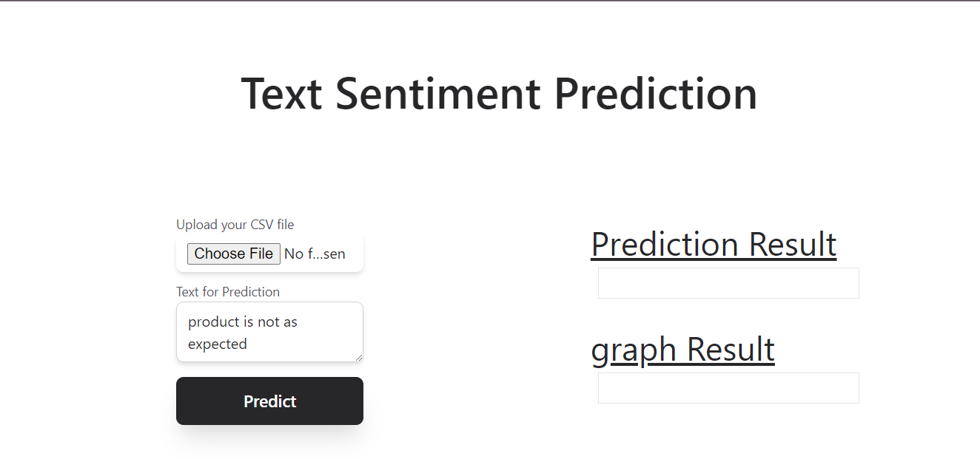
Result

Slide 7
Advantages
Understanding Customer Feedback
Risk Management
Product Development
Customer Service Optimization

Slide 8
Applications
Business
Social Media
Customer Services
Health Care
Political Analysis
Market Research
Future Enhancements
To extend this project by adding some more features includes neutral classification component

Slide 9
Thank You

